Slide 1
Smithgall Woods Park Website
Final Project Update
MIST7590 – MIT Project I
Andrea Castresana
Jennifer Lazo
Alexander Couch
Clark Williams
Eliseo Santos
November 29, 2017

Slide 2
SGW Website was hacked!

Slide 3
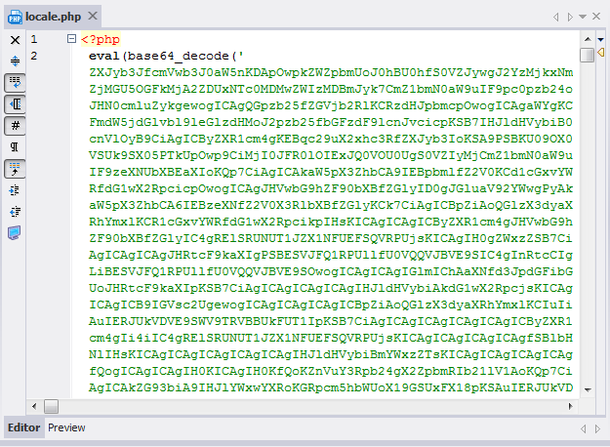
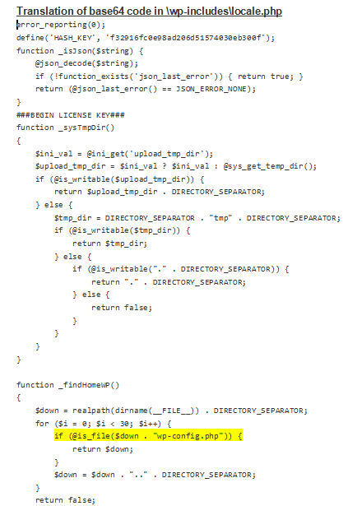
Malicious Code Injection
~June 6, 2016 – successful hacking
eval (base64_decode (‘…….’));
Notes:
wp-config.php – This is also one of the highly targeted files by the hackers.

Slide 4
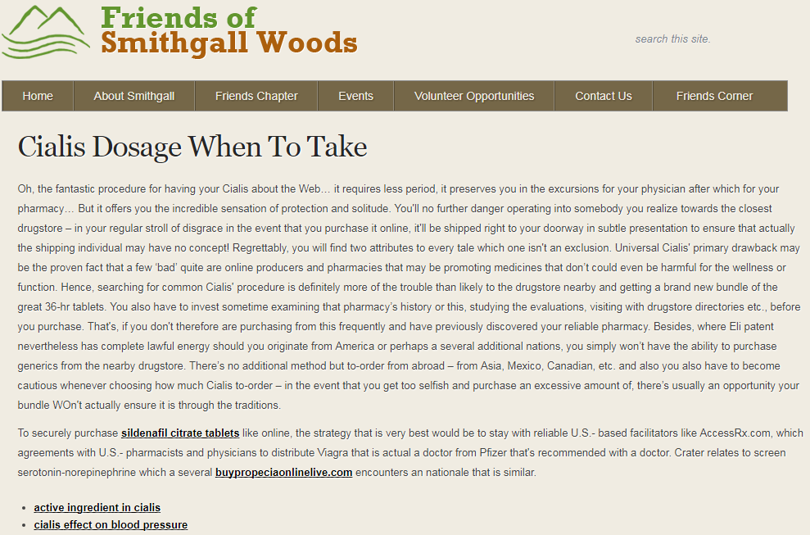
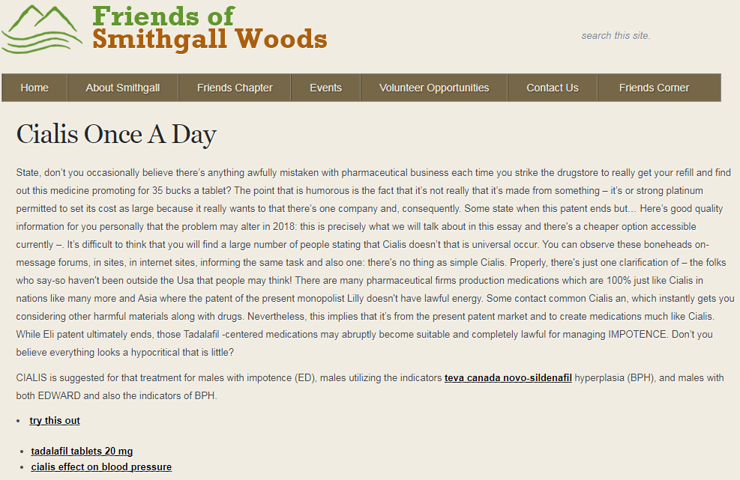
Malicious Code Injection
Malicious messages displayed
Hyperlinks to Fraudulent Sites

Slide 5
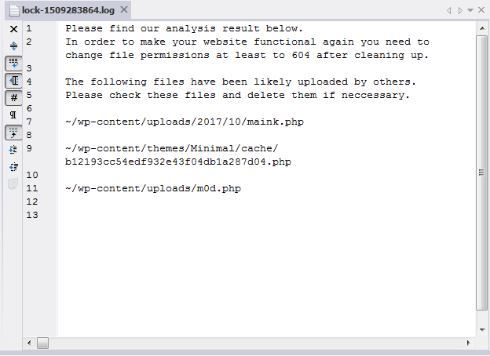
WordPress Hacking
October 29, 2017 – unsuccessful attempt
Attempted to upload malicious files
Ukraine and Netherlands
Locked three files
Notes:
October 29, 2017 – unsuccessful attempt
Attempted to upload malicious files
Also attempted to access WP login accounts
Ukraine and Netherlands
Site host 1and1.com was able to lock these three files which prevented the hacking attempt.

Slide 6
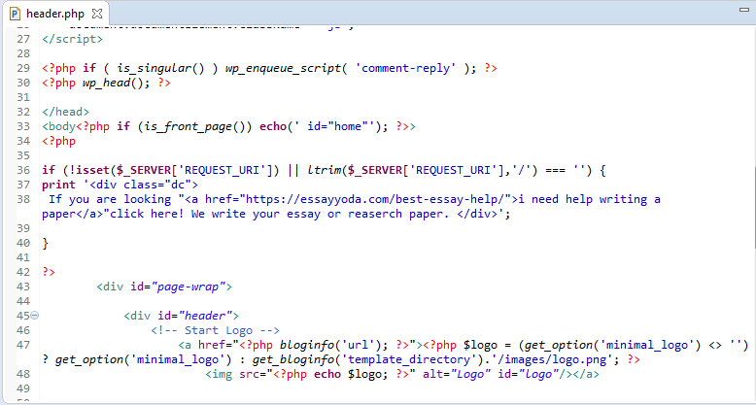
Malicious Code Injection
October 30, 2017 – successful injection
Changed header.php & style.css
Mountain View, California

Slide 7
Project Summary
Problem
Difficult to update/maintain site and Volunteer app
Outdated PHP, WP themes and plugins
Degraded site security
Solution
Rebuild site using current WordPress/PHP
Site hosting either 1&1.com or Bluehost
Establish detailed Admin Documentation
Train FSGW Reps
Notes:
Criteria for website hosting:
Code must be accessible and portable
Cost must be below $20
Site security must be include SiteLock and SSL Certificate

Slide 8
Benefits to Users
Better User Experience
Easier to Find Information
Improved Site Security
Sufficient Documentation for Admins

Slide 9
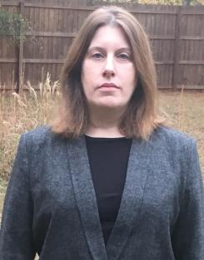
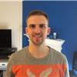

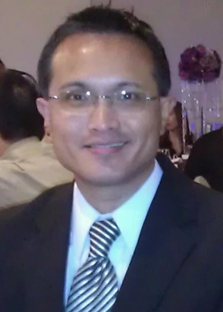
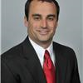
Meet the Team
Andrea Castresana
Requirements Manager Client-side Developer
Jennifer Lazo
Client-side/Server-side Developer
Alexander Couch
UX Design Manager Server-side Developer
Clark Williams
Database Manager
Requirements Manager
Eliseo Santos
Project Manager
Test Manager

Slide 10
Site Map
1.0
FSGW Home Page
1.1
Search Box
2.0
Home
4.0
Activities
6.0
Volunteer Opportunities
3.1
Mission Statement
4.2
Roads & Trails
3.2
History
3.3
Meetings (Calendar)
3.4
Become a Friend or Volunteer
6.1
Adopt-A-Trail
8.0
Visitors
9.0
Contact Us
3.0
About Us Friends
8.1
Cottage & Facility Accommodations
1.2
Volunteer Login
7.0
Friends Corner
7.1
Photo Gallery
7.2
Newsletter
7.3
Wish List
4.3
Trout Fishing
4.4
Hunting
4.5
Geocaching
4.6
Group Camping
4.7
Education
6.2
Van Tours
6.3
Guided Hikes
6.4
Projects
6.5
Donations
8.2
Visitor Center
New Category /Subcategory
Relocated
8.3
Directions
Existing Category /Subcategory
3.5
Frequently Asked Questions
5.0
Events
4.1
All Access Trail
Legend

Slide 11
User Stories
Friends Chapter Member
Administrator
Visitor
Notes:
Friends Chapter Member:
Create and update member profile
Subscribe to newsletter
Add and view volunteer hours
Administrator:
Create, update, delete admin profile
Update and delete volunteer profile
Add volunteer hours
Generate quarterly reports
Visitor:
Navigate easily through the website
Find information about renting a cabin

Slide 12
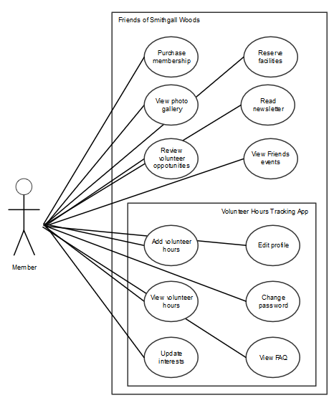
Friends Volunteer Use Cases
Notes:
The person who performs volunteer work for Smithgall Woods (SGW) is a Friends Chapter member. All other volunteers that are NOT Friends Chapter members are tracked through the Georgia State Park website.

Slide 13
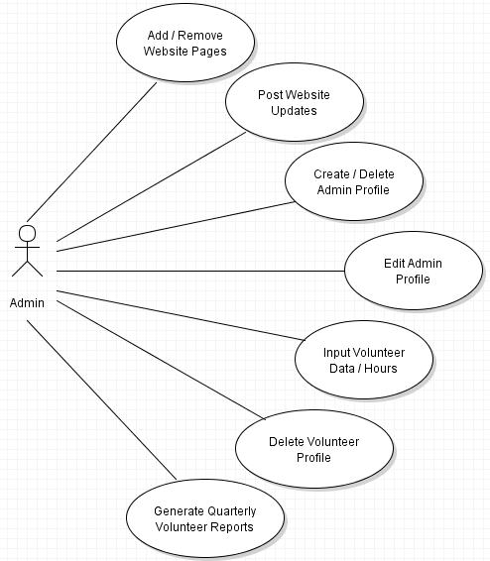
Admin Use Cases

Slide 14
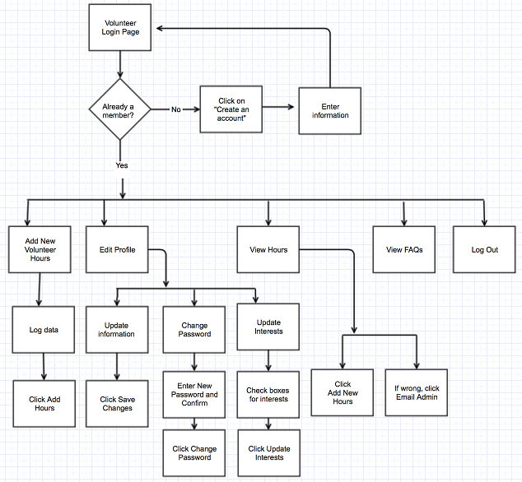
Friends Volunteer Workflow
Notes:
This Friends Chapter Volunteer workflow describes the existing Friends Volunteer Hours Log process. The next iteration of the website will use similar workflow for the Friends Chapter volunteers. The volunteer page starts with a login, and a member volunteer will still be able to Add New Volunteer Hours, Create/Edit Profile, Update Interests, View Hours, etc.

Slide 15
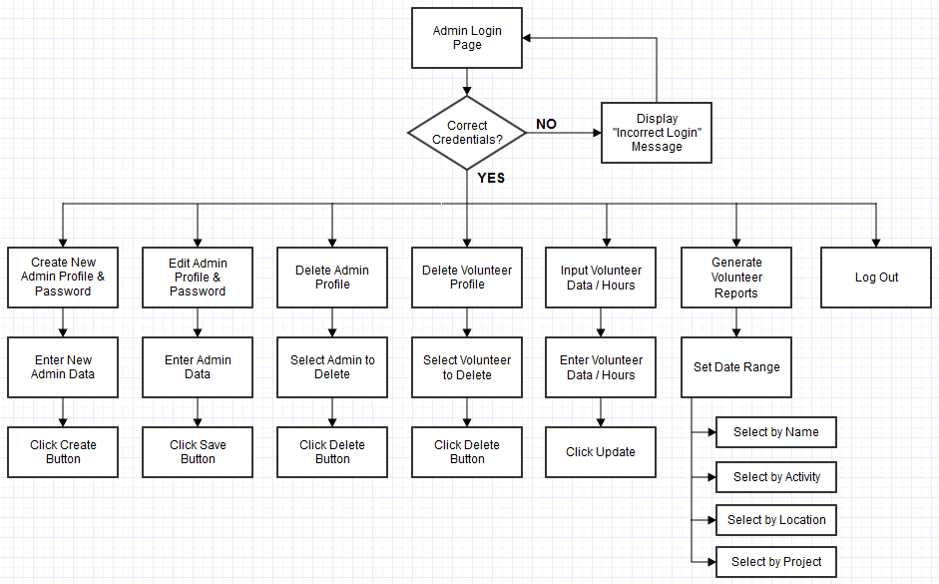
Admin Workflow
Notes:
This Admin Workflow is based on the proposed user/system requirements. A separate login page for Admin will be developed, and an Admin/Password pair will be set up initially in the MySQL “admin_login” table. Then, the Admin must log in first to create user accounts with admin privileges.

Slide 16
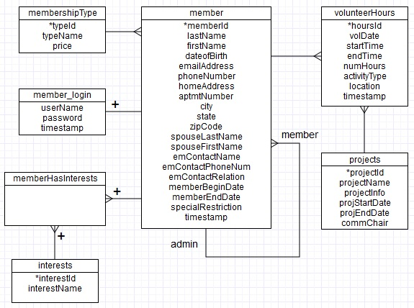
Data Model
Notes:
This data model is based on the user/system requirements. The admin is also a Friends Chapter member who can update and delete all members profile. Also, the admin can create, update, and delete other admin profile. Therefore, the recursive relationship is used to define the admin-member relationship.
The “projects” table is added here to identify the type of project in which a volunteer participated.

Slide 17
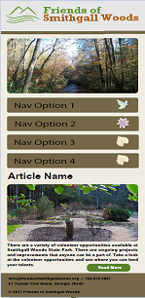
Home Page Mockup (Mobile Version)
Notes:
This is a suggested mobile mockup…….

Slide 18
System Requirements
Website Pages/Navigation
Website Construct
Cottage and Facility Accommodations
Volunteer Hours Log App
Volunteer Reports App
Notes:
Description of each Site Feature
Website Pages/Navigation:
The team will re-arrange the site content to improve its appearance and make it more interesting to users and future visitors to the site
Will also reorganize navigation bar for logical menu structure
Client wants to add two pages (About Us Friends, All Access Trail)
Website Construct:
Team will rebuild the site using a user-friendly web content management tool that allows SGW representative to easily maintain and update the site
Users Guide and training will be provided to client
Cottage & Facility Accommodations:
Update all page links to relevant sites
Renamed to Cottage & Facility Accommodations
Only the cottages are reserved online. Other park facilities are arranged with the Visitor Center, (706) 878-3087
Volunteer Hours Log App:
Will be improved for Friends Chapter volunteers to easily log their volunteer hours data
Will be formatted for both desktop and mobile devices using Bootstrap technology to make data entry easier and improve user experience
Will also track volunteer hours from Hardman Farm through SGW site app; Hardman Farm reports volunteer hours and earns revenue from the State
Volunteer Reports App:
Will be developed for administrator’s use to ease the management of the Volunteer Hours Log and generate quarterly volunteer reports
Will provide admin the ability to update and delete admin and volunteer profiles

Slide 19
Project Schedule
 |  | CY2017 |  |  |  | CY2018
Task Phase | Task Description | S | O | N | D | J | F | M | A
Initiation & Planning | 1. Conduct System Analysis of Current Site
 | 2. Propose Security Remediation Plan
 | 3. Establish Proposed System Requirements
 | 4. Meet with Project Stakeholders
 | 5. Develop Logical Models
 | 6. Conduct Testing of WordPress / Prototype
 | 7. Research Web Content Management Tool
 | 8. Finalize Requirements & Project Charter
Project Execution | 9. Start Rebuilding the Website/Volunteer App
 | 10. Test First Increment Version of Site/App
 | 11. Finish Rebuilding the Entire Site/App
 | 12. Test Final Rebuild of Website/App
Project Closure | 13. Establish Documentation
 | 14. Deploy Production Version of Website
 | 15. Conduct Training on Website Maintenance
 | 16. Hold Project Closure Meeting with Client

Slide 20
Challenges
Lack of communication between team & client
Limited experience on WP & PHP
Original codes are not available

Slide 21
Way Ahead
Train all team members on WordPress & PHP
Assign site rebuilding tasks
Begin rebuilding website in December
Notes:
Train all team members on WordPress & PHP
Tutorials by LearnWebCode & Lynda.com
Assign site rebuilding tasks to each team member; rebuild is consisted of 3 parts
Main SGW Website
Volunteer Hours Log App
Volunteer Reports App (Secondary site)
Begin rebuilding website in December

Slide 22
Questions

